Slide 1

TRAFFIC FATALITIES ANALYSIS

Slide 2
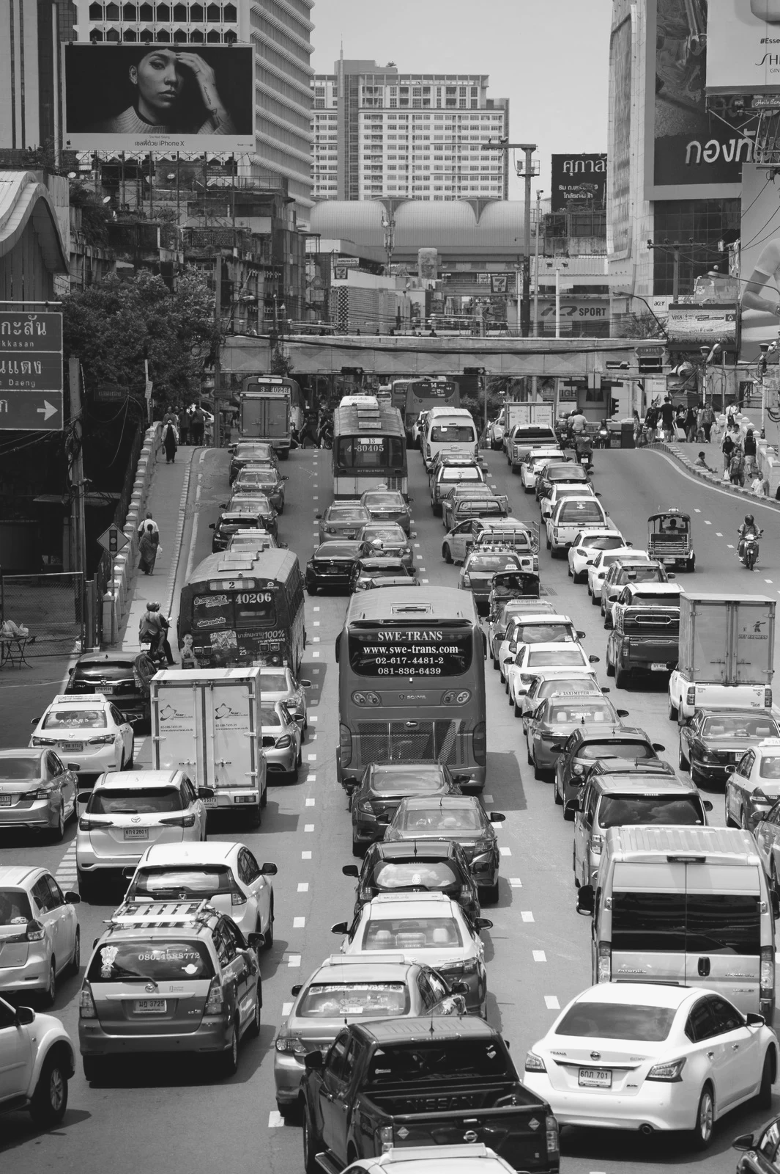

Agenda
Topics to be Discussed
Need for the Study
Exploring key drivers
Model and Analysis
Real World Applications

Slide 3

The Devastating Human Toll of Traffic-Related Deaths
Every year, millions of people worldwide lose their lives due to traffic accidents, leaving behind grieving families and shattered communities.
The emotional and psychological impact of traffic fatalities extends far beyond the immediate victims, affecting loved ones, friends, and colleagues.
Tragically, many traffic accidents are preventable, highlighting the need for proactive measures to reduce risks and improve road safety.
Presented by Rachelle Beaudry

Slide 4

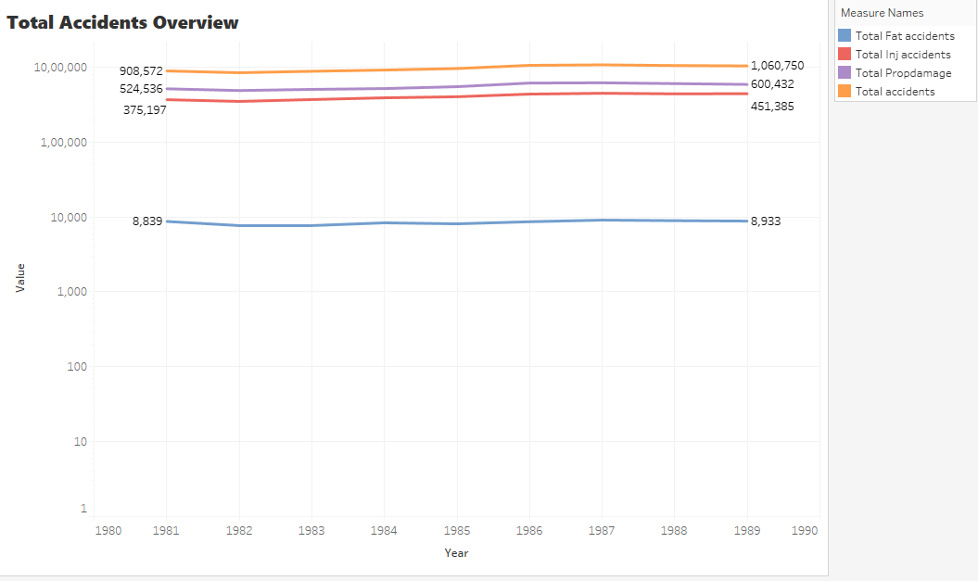
Accidents Overview
20%
Of Total Accidents
There are certain policies that are implemented, though the rise in accidents is significant over 1980 - 90.

Slide 5

Staggering Economic Costs of Traffic Fatalities
1.3T
$230B
Global Cost
US Cost
Traffic accidents are a significant drain on global economies, resulting in billions of dollars in lost productivity, healthcare expenses, and infrastructure repairs.
The United States alone experiences hundreds of billions of dollars in annual costs related to traffic fatalities and injuries.
Presented by Rachelle Beaudry

Slide 6




Understanding the Factors Contributing to Fatalities
Driver Behavior
Road Infrastructure
Vehicle Design
Distracted driving, speeding, and impaired driving are among the most common contributing factors to traffic accidents.
Poor road design, lack of safety features, and inadequate lighting can increase the risk of accidents and fatalities.
Vehicle design, including safety features like airbags and anti-lock brakes, play a crucial role in mitigating the severity of accidents.
Presented by Rachelle Beaudry

Slide 7
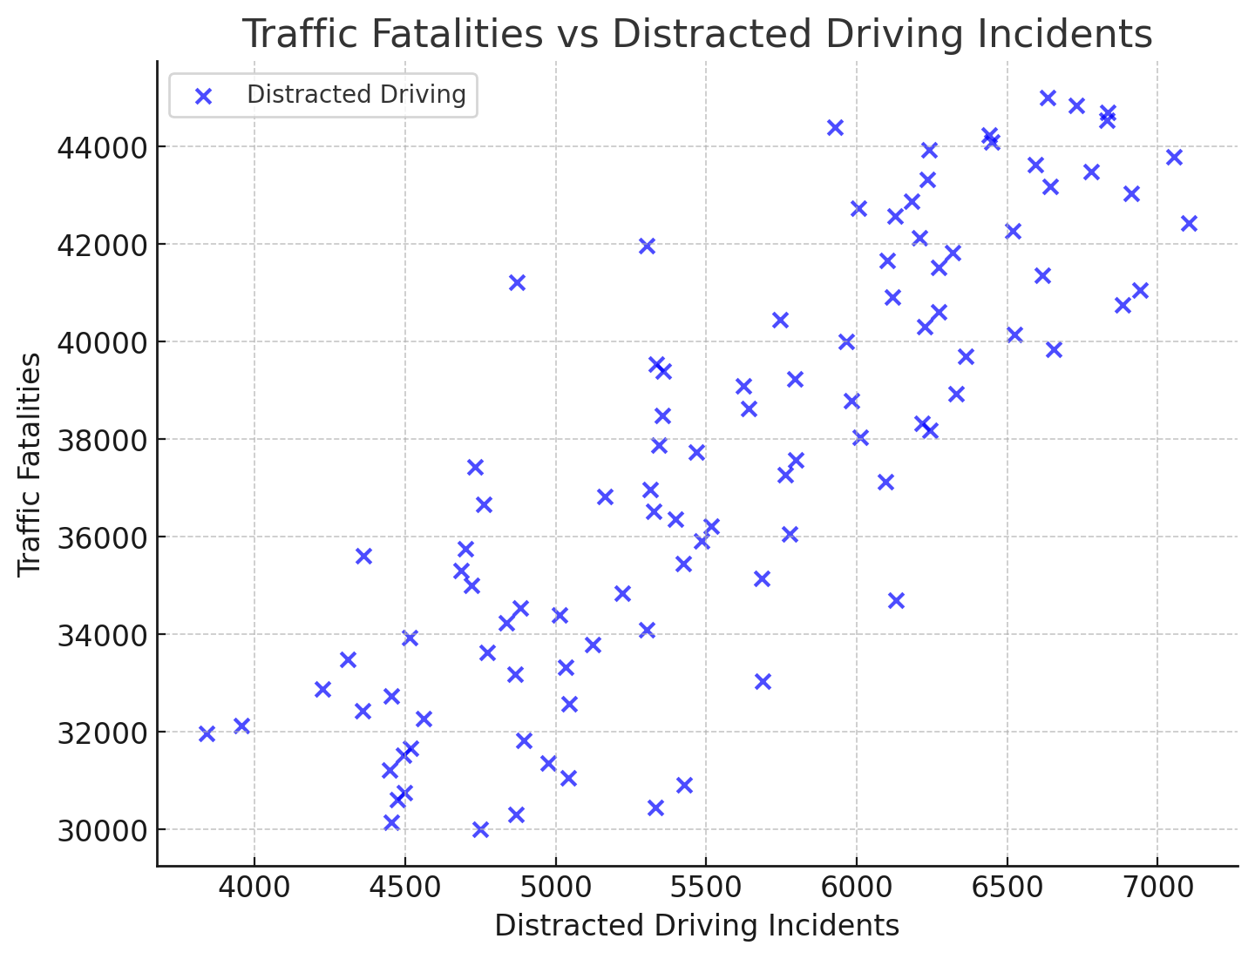
Traffic Fatalities vs Distracted Drivers
+0.75
(Strong +ve correlation)
For every 100 additional distracted driving incidents, there is an average increase of 15 traffic fatalities.
Impact

Slide 8
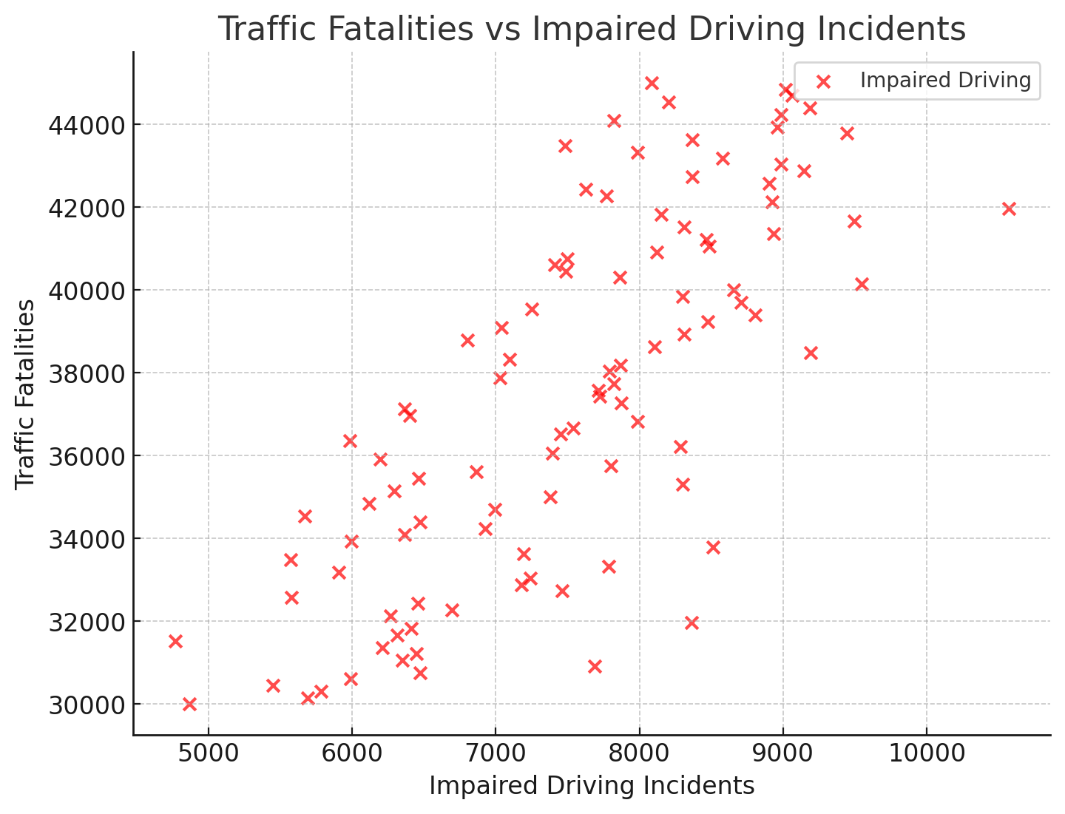
Traffic Fatalities vs Impaired driving Incs
+0.80
(Strong +ve correlation)
For every 100 additional distracted driving incidents, there is an average increase of 20 traffic fatalities.
Impact

Slide 9
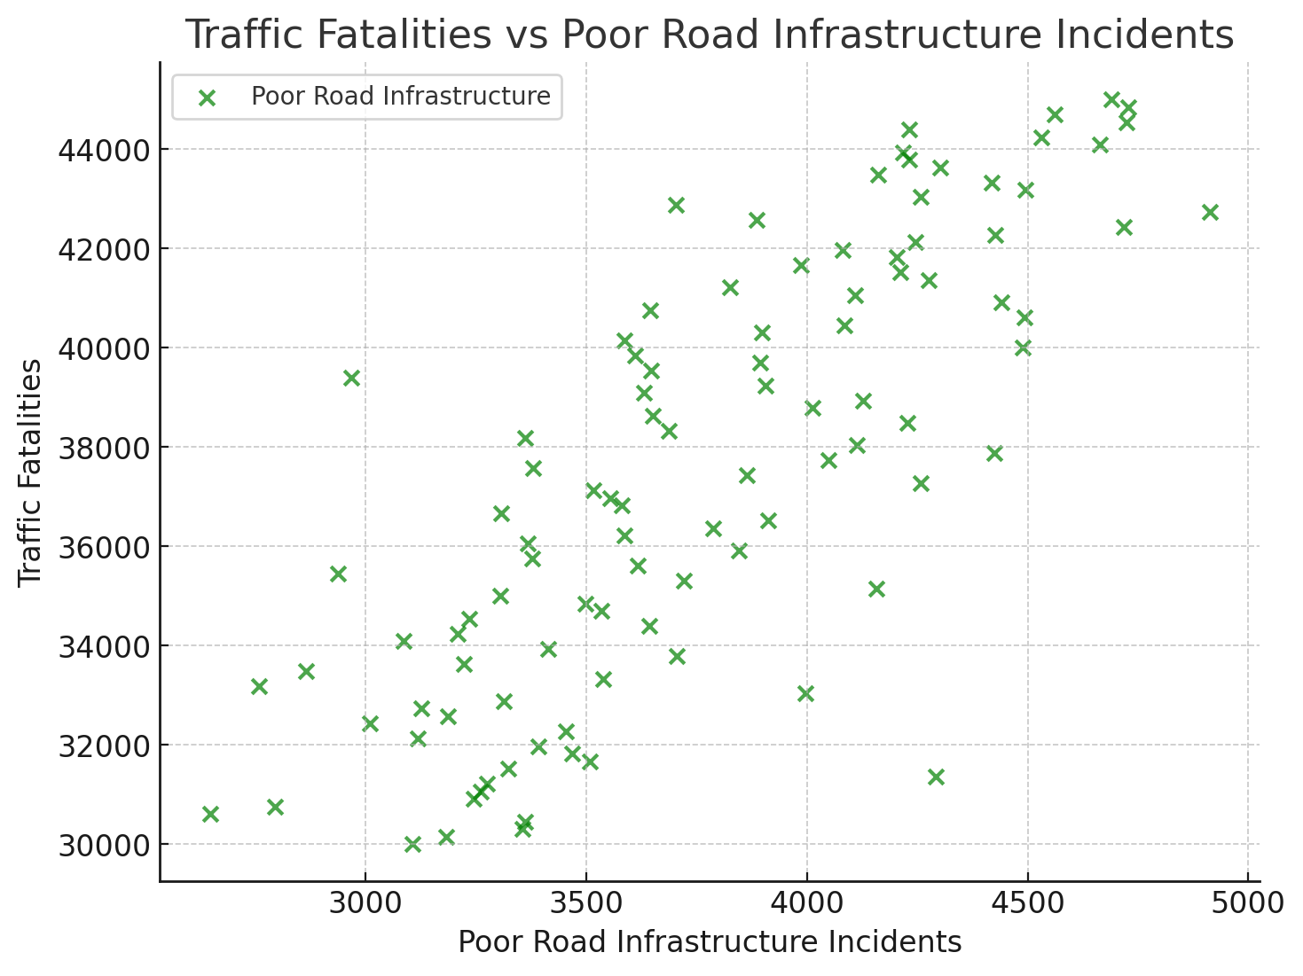
Traffic Fatalities vs Poor Infra
+0.65
(Strong +ve correlation)
For every 100 additional distracted driving incidents, there is an average increase of 10 traffic fatalities.
Impact

Slide 10
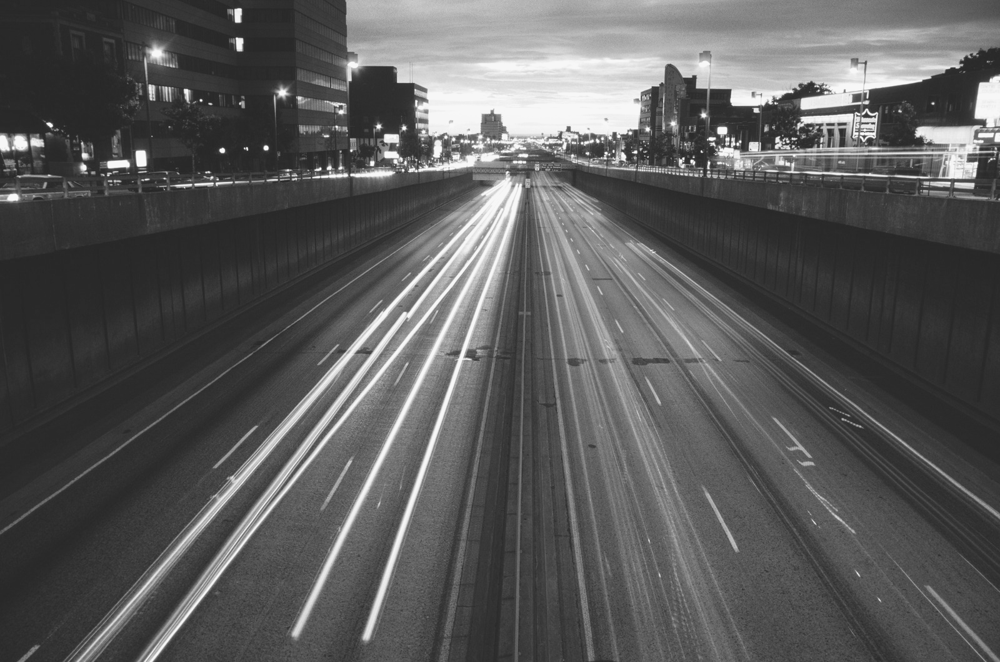
TAKE AWAY
Previously shown figures emphasize the critical need for targeted interventions in distracted and impaired driving prevention, as well as improvements in road infrastructure to reduce fatalities effectively.
Research and Statistics
Presented by Rachelle Beaudry

Slide 11

MODEL SPECIFICATION
dthrateit= β0 + β1⋅Lawit + β2⋅Speedit + δ_i + γ_t + ϵit
​Dependent Variable: dthrateit​ (fatality rate)
dthrate_it is the traffic fatality rate for state i at time t
Independent Variables: Lawit​(indicator for laws), Speedit​(speed limits).
Law_it is a binary indicator for specific laws in place (e.g., cadmn, copen, cspeed).
Residual Term (ϵit)​:
Represents unobserved factors influencing traffic fatalities that are not captured by the model

Slide 12
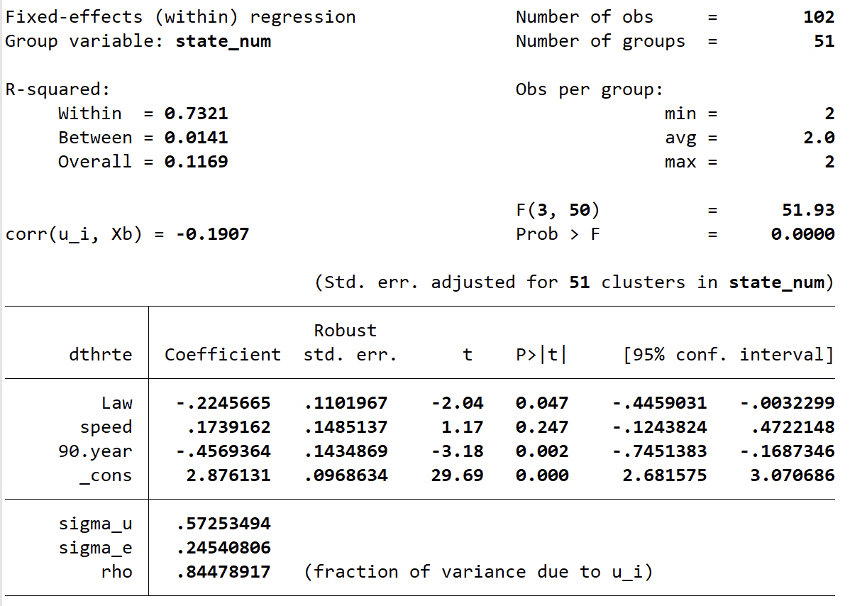
RESULTS
Key Coefficients:
Law (β1​):
β1 value: ~ −0.225
Interpretation:
The coefficient is negative and statistically significant (p<0.05)
Meaning: Stricter traffic laws reduce traffic fatalities by 0.225 units on average for each additional law.
Example: A state that implements more traffic laws may see its fatality rate drop from 2.5 to 2.275 fatalities per 100,000 population.
Policy Implication: Policymakers should focus on expanding and enforcing such laws to improve road safety.

Slide 13
RESULTS
Key Coefficients:
Speed (β2​):
β2 value: ~ 0.174
Interpretation:
The coefficient is positive but not statistically significant (p>0.05).
Meaning: While higher speed limits are associated with increased fatality rates, the relationship is not definitive in this dataset.
Example: A state that implements more traffic laws may see its fatality rate drop from 2.5 to 2.275 fatalities per 100,000 population.
Policy Implication: Further research is needed to confirm the effect of speed limits, but caution is warranted when setting high limits.

Slide 14
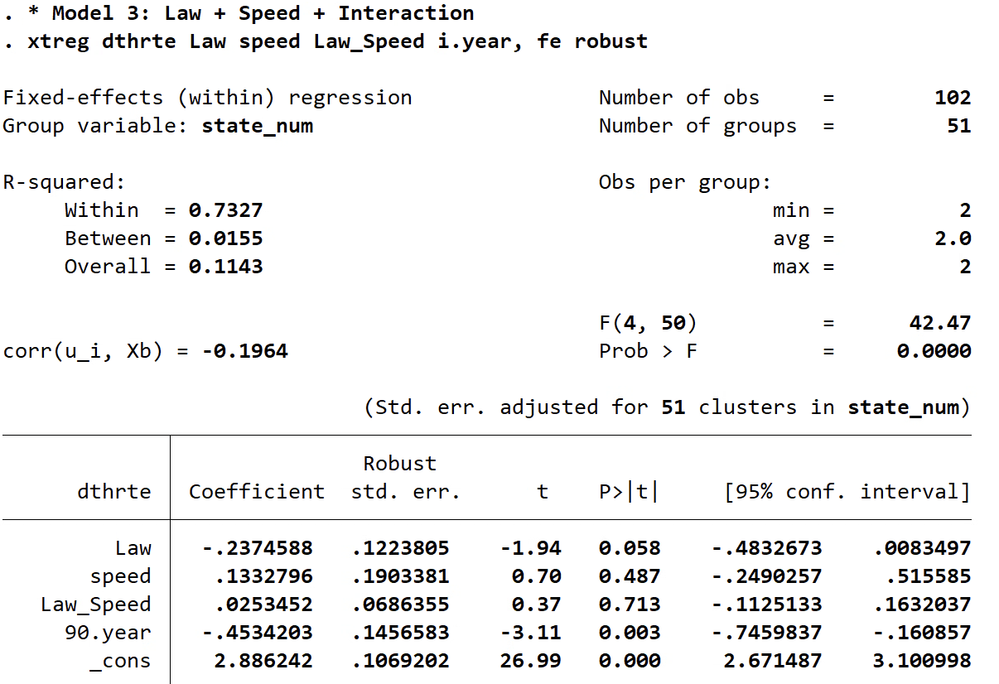
RESULTS
After adding interaction variable(β3):
dthrateit​ = β0​ + β1​⋅Lawit​ + β2​⋅Speedit ​+ β3​⋅(Law × Speed)it​ + ϵit​
Law x Speed (β3​):
β3 value: ~
Interpretation:
The coefficient is positive but not statistically significant (p>0.05).
Meaning: While higher speed limits are associated with increased fatality rates, the relationship is not definitive in this dataset.
Example: A state that implements more traffic laws may see its fatality rate drop from 2.5 to 2.275 fatalities per 100,000 population.
Policy Implication: Further research is needed to confirm the effect of speed limits, but caution is warranted when setting high limits.

Slide 15
DEATH RATES 90 vs 85

Slide 16
RECOMMENDATIONS FOR REDUCING FATALITY RATE
Actionable Policy Implications:
Stricter Traffic Laws:
Expand laws like administrative penalties and open-container restrictions.
Increase enforcement to achieve measurable reductions in fatalities.
Evaluate Speed Limits:
Consider lower speed limits in high-risk states.
Study enforcement effectiveness to clarify speed-fatality relationships.
Targeted Interventions:
Focus on states with persistently high fatality rates (identified by fixed effects).
Improve road infrastructure in high-risk areas.

Slide 17

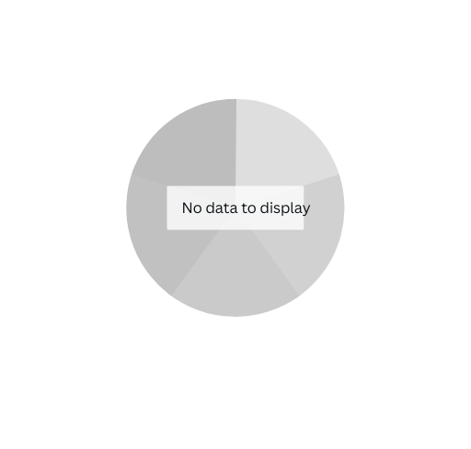

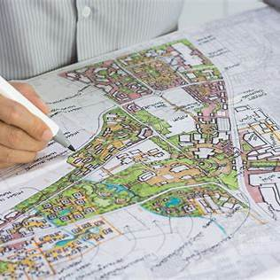

Real World Findings
Policymakers
Urban Planners
Public Health Campaigns
Presented by Rachelle Beaudry

Slide 18
Policymakers
Strengthen Enforcement of Traffic Laws
Implement stricter penalties for impaired driving, distracted driving, and other high-risk behaviors.
Data-Driven Policy Reforms
Use findings from analysis to identify high-risk regions and demographics requiring targeted interventions.
Expected Measurable Outcomes
A 15–20% reduction in traffic fatalities in areas with stricter enforcement has been observed..
Presented by Rachelle Beaudry

Slide 19
Urban Planners
Focus on High-Risk Areas :
Identify and redesign accident-prone roads and intersections highlighted in the analysis.
Invest in Safer Infrastructure:
Build separate bike lanes and pedestrian walkways to reduce collisions.
Improve lighting and visibility on poorly lit roads to prevent night-time accidents.
.

Slide 20

Public Health Campaigns
Raise Awareness Through Campaigns - Design impactful campaigns addressing the dangers of speeding, distracted driving, and alcohol consumption.
Promote Behavioral Change -Highlight success stories and testimonials from individuals or regions with reduced fatalities.

Slide 21
Broader Societal Benefits
Improved Community Safety
Reduced Healthcare Costs
Reducing traffic fatalities fosters safer neighborhoods, encouraging more pedestrian and cyclist activity while boosting trust in public infrastructure.
Fewer accidents mean less strain on emergency services, hospitals, and long-term care systems, freeing resources for other critical healthcare needs..
Enhanced Quality of Life
Actionable Recommendations
Safer roads lead to better mental and physical well-being, creating more connected and thriving communities for all residents.
Advocate for stricter laws, safer infrastructure, and targeted awareness campaigns to achieve measurable improvements in road safety.

Slide 22

We're open for questions and comments.
Thank You & Happy Holidays!

